Slide 1
Requirement Engineering

Slide 2
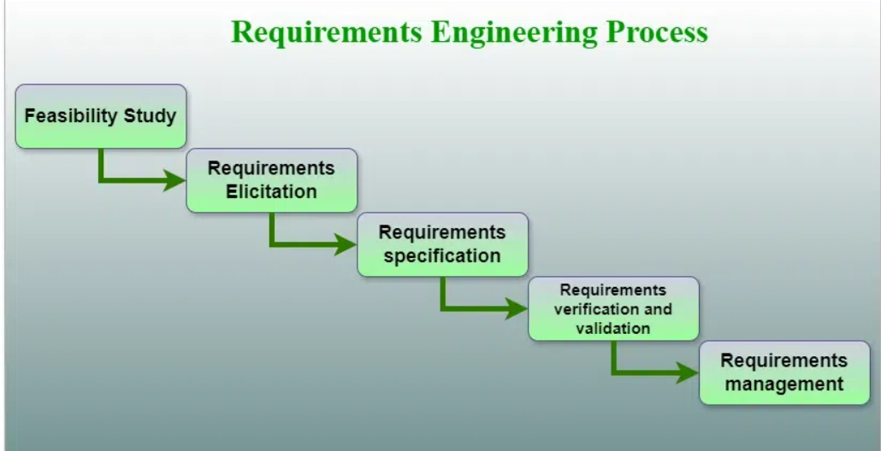
Requirement Engineering
Requirements Engineering is the process of identifying, eliciting, analyzing, specifying, validating, and managing the needs and expectations of stakeholders for a software system.

Slide 3
Steps of Requirement Engineering
Feasibility Studies
Requirements Elicitation
Requirements Specification
Requirements Verification and Validation
Requirements Management

Slide 4
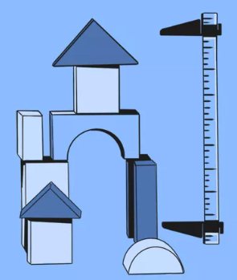
Feasibility Study
Feasibility study checks whether the project is feasible/possible or not. It evaluates technical, operational, economic, legal, and schedule aspects of a project.
Technical Feasibility: In Technical Feasibility current resources both hardware software along required technology are analyzed/assessed to develop the project.
Operational Feasibility: In Operational Feasibility degree of providing service to requirements is analyzed along with how easy the product will be to operate and maintain after deployment.

Slide 5
Feasibility Study
Economic Feasibility: In the Economic Feasibility study cost and benefit of the project are analyzed.
Legal Feasibility: In legal feasibility, the project is ensured to comply with all relevant laws, regulations, and standards.
Schedule Feasibility: In schedule feasibility, the project timeline is evaluated to determine if it is realistic and achievable.

Slide 6

Requirements Elicitation
It focuses on gathering stakeholder needs and domain knowledge about the project. Source of knowledge includes customers, business manuals, the existing software of the same type, standards, and other stakeholders of the project. Several techniques can be used to elicit requirements, including:
Interviews: These are one-on-one conversations with stakeholders to gather information about their needs and expectations.
Surveys: These are questionnaires that are distributed to stakeholders to gather information about their needs and expectations.

Slide 7
Requirements Elicitation
Focus Groups: These are small groups of stakeholders who are brought together to discuss their needs and expectations for the software system.
Observation: This technique involves observing the stakeholders in their work environment to gather information about their needs and expectations.
Prototyping: This technique involves creating a working model of the software system, which can be used to gather feedback from stakeholders and to validate requirements.

Slide 8
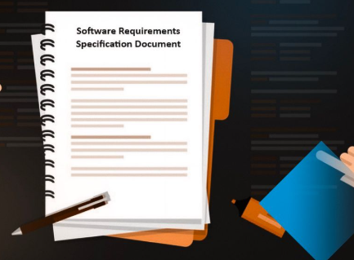
Requirements Specification
The process of documenting the requirements identified in the requirement elicitation step in a clear, consistent, and unambiguous manner. This step also involves prioritizing and grouping the requirements into manageable chunks.
Uses models like data flow diagrams (DFDs), ER diagrams, data dictionaries, function decomposition diagrams (FDDs) etc.
Clear and comprehensive document, should be understood by both the development team and the stakeholders.

Slide 9
Requirements Specification
Several types of requirements are commonly specified in this step, including:
Functional Requirements: These describe what the software system should do.
Non Functional Requirements: These describe how well the software system should do it.
Constraints: These describe any limitations or restrictions that must be considered when developing the software system.
Acceptance Criteria: These describe the conditions that must be met for the software system to be considered complete and ready for release.

Slide 10
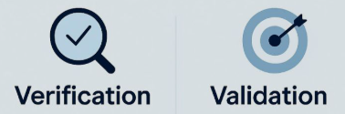
Requirements Verification and Validation
Verification is checking that the requirements are complete, consistent, and accurate. It involves reviewing the requirements to ensure that they are clear, testable, and free of errors and inconsistencies. This can include reviewing the requirements document, models, and diagrams, and holding meetings and walkthroughs with stakeholders.
Validation is the process of checking that the requirements meet the needs and expectations of the stakeholders. It involves testing the requirements to ensure that they are valid and that the software system being developed will meet the needs of the stakeholders. This can include testing the software system through simulation, testing with prototypes, and testing with the final version of the software.

Slide 11

Requirements Management
The process of analyzing, documenting, tracking, prioritizing, and agreeing on the requirement and controlling the communication with relevant stakeholders.
This stage takes care of the changing nature of requirements.
The goal of requirements management is to ensure that the software system being developed meets the needs and expectations of the stakeholders and that it is developed on time, within budget, and to the required quality.

Slide 12
Requirements Management
Several key activities are involved in requirements management:
Tracking and controlling changes: Monitoring and controlling changes to the requirements, including identifying the source of the change, assessing the impact of the change, and approving or rejecting the change.
Version control: This involves keeping track of different versions of the requirements document and other related artifacts.
Traceability: This involves linking the requirements to other elements of the development process, such as design, testing, and validation.
Communication: This involves ensuring that the requirements are communicated effectively to all stakeholders and that any changes or issues are addressed promptly.
Monitoring and reporting: This involves monitoring the progress of the development process and reporting on the status of the requirements.

Slide 13

Advantages
Helps ensure that the software being developed meets the needs and expectations of the stakeholders.
Can help identify potential issues or problems early in the development process, allowing for adjustments to be made before significant.
Helps ensure that the software is developed in a cost-effective and efficient manner.
Helps to ensure that the software system meets the needs of all stakeholders.
Helps to ensure that the software system is delivered on time, within budget, and to the required quality standards.

Slide 14

Disadvantages
Can be time-consuming and costly, particularly if the requirements-gathering process is not well-managed.
Can be difficult to ensure that all stakeholders' needs and expectations are taken into account.
Requirements may change over time, which can result in delays and additional costs.
There may be conflicts between stakeholders, which can be difficult to resolve.

Slide 16
References
Slides adapted from Didarul Islam Didar, Lecturer, Dept. of CSE, UIU
Requirements Engineering Process in Software Engineering - GeeksforGeeks

Slide 17
THANK YOU ^_^ !!!

